Slide 1
STEGANOGRAPHY
CAPSTONE PROJECT
Presented By:
Student Name : AKSHAT BAJPAI
College Name & Department : GALGOTIAS UNIVERSITY (BTECH CSE)

Slide 2
OUTLINE
Problem Statement
Technology used
Wow factor
End users
Result
Conclusion
Git-hub Link
Future scope

Slide 3
Problem Statement
Steganography is a technique for hiding information within digital media to ensure secure and covert communication. Traditional methods face challenges like limited data capacity and vulnerability to detection. This project aims to enhance steganographic techniques for improved security and robustness.

Slide 4
Technology used
✔ Programming Languages: Python, Java, C++ (for implementing algorithms).
✔ Image Processing Libraries: OpenCV, PIL (Python Imaging Library).
✔ Cryptography: AES, RSA (for added encryption security).
✔ Machine Learning (Optional): TensorFlow, Scikit-learn (for steganalysis prevention).
✔ Web Development (If Web-Based): HTML, CSS, JavaScript, Flask/Django.
✔ Database (If Needed): MySQL, Firebase, MongoDB (for storing stego-images).

Slide 5
Wow factors
✅ Dual Security (Encryption + Steganography): Combining AES/RSA encryption with steganography for double-layer protection.
✅ Multiple File Type Support: Hiding data in images, audio, video, or even PDFs for versatile usage.
✅ AI-Powered Steganalysis Prevention: Using machine learning to detect and counteract steganalysis techniques.
✅ Real-Time Encoding & Decoding: Fast and efficient steganographic processing with an easy-to-use interface.
✅ Invisible Watermarking Feature: Protecting digital copyrights by embedding hidden ownership information.
✅ User-Friendly Interface: Simple drag-and-drop functionality for encoding and decoding hidden messages.

Slide 6
End users
Cybersecurity Professionals – For secure communication and data protection.
Government & Intelligence Agencies – To exchange classified information without detection.
Journalists & Whistleblowers – For confidential reporting and protecting sources.
Businesses & Corporations – To secure sensitive company data and digital assets.
Forensic Experts & Law Enforcement – For investigating cybercrimes and digital forensics.
Content Creators & Artists – For digital watermarking and copyright protection.
General Users – For personal data privacy in emails, images, and documents.

Slide 7
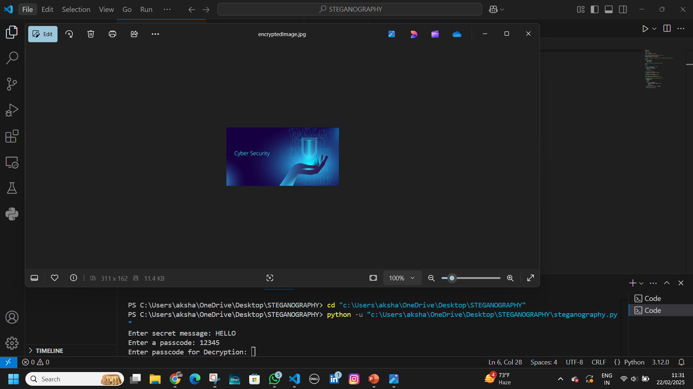
Results

Slide 8
Conclusion
✔ Definition & Purpose – Steganography is a technique for hiding information within digital media, ensuring covert communication.
✔ Comparison with Cryptography – Unlike encryption, which scrambles data, steganography hides the message’s existence, making it more discreet.
✔ Applications – Used in cybersecurity, digital watermarking, confidential data transmission, and forensic investigations.
✔ Challenges – Vulnerable to steganalysis (detection techniques), limited data-hiding capacity, and evolving security threats.
✔ Future Scope – Integration with AI, machine learning, and encryption to improve robustness, security, and resistance to detection.
✔ Overall Significance – A crucial tool for secure communication, with ongoing research needed to enhance its effectiveness in digital security. 🚀

Slide 9
GitHub Link
https://github.com/Akshat-12345/STEGANOGRAPHY

Slide 10
Future scope(optional)
1. Enhanced Security Features
Implement AES or RSA encryption alongside steganography for double-layer security.
Use password protection to restrict unauthorized access.
2. Support for Multiple File Types
Extend from image-based steganography to audio, video, and text files.
Implement PDF or DOCX steganography for secure document sharing.
3. AI and Machine Learning Integration
Use AI models to detect and prevent steganalysis attacks.
Implement deep learning techniques to improve embedding efficiency.
4. Real-World Applications
Secure communication for journalists, activists, or government agencies.
Digital watermarking for copyright protection in images and videos.
Forensic applications to hide confidential case-related data.

Slide 11
THANK YOU

